Slide 1

Higher-order functions
examples

Slide 2
Member
fun compare x (y,acc) = acc orelse x = y;
fun member x ys = foldr (compare x) false ys;
member 2 [3,5,2,4];
member 2 [];
member 2 [1,3,4];

Slide 3
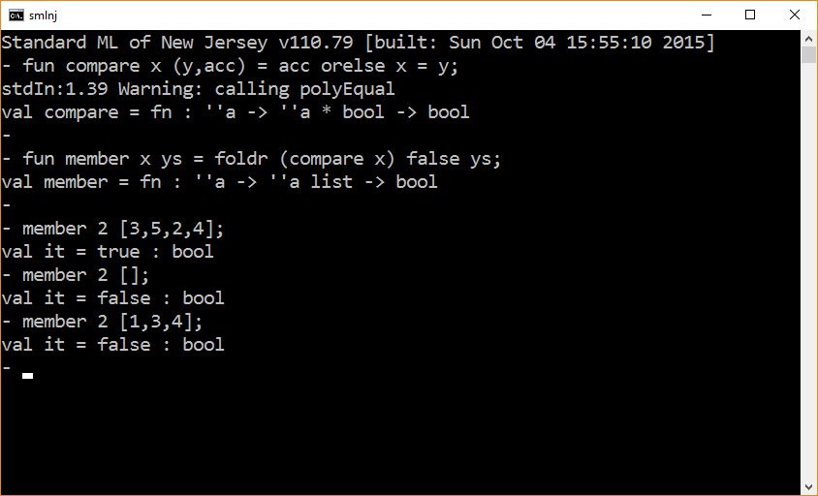

Slide 4
Member revisited
fun or (v,w) = v orelse w;
fun member x ys = foldr or false (map (fn y => x = y) ys);
member 2 [3,5,2,4];
member 2 [];
member 2 [1,3,4];
* orelse and andalso are not actual operators. Hence, they
cannot be used with op.

Slide 5
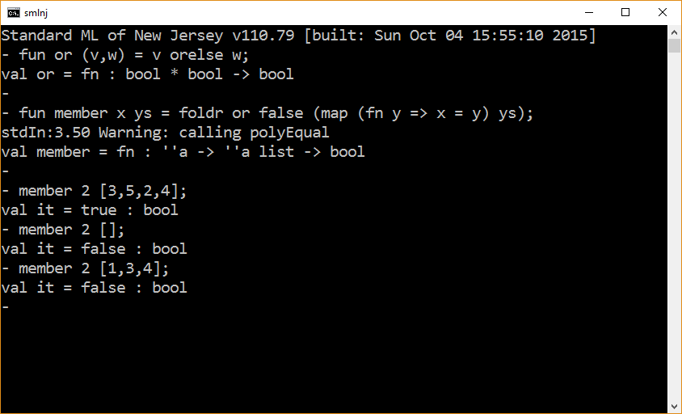

Slide 6
Exists ('a -> bool) -> 'a list -> bool
fun or (v,w) = v orelse w;
fun isEven x = x mod 2 = 0;
fun exists p xs = foldr or false (map p xs);
exists isEven [1,3,5,6,7,9];
exists isEven [1,3,5,7,9];
exists isEven [];
*exists is part of the List structure

Slide 7
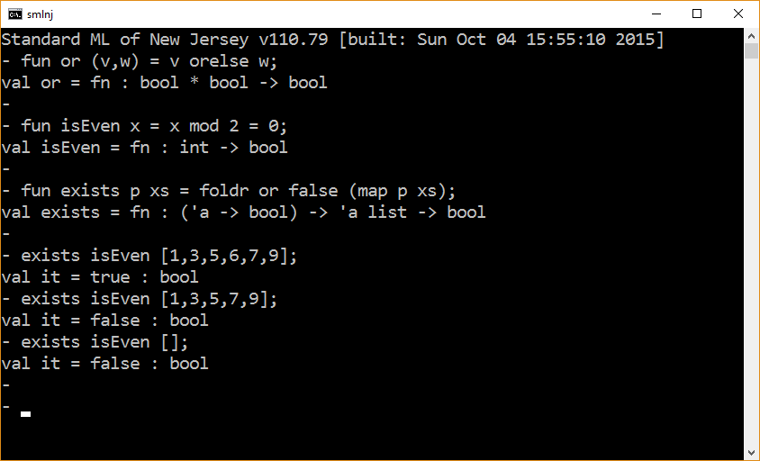

Slide 8
Reverse
foldl op :: [] [1,2,3,4];
fun rcons (x,xs) = xs @ [x]; (* in general avoid this *)
foldr rcons [] [1,2,3,4];

Slide 9
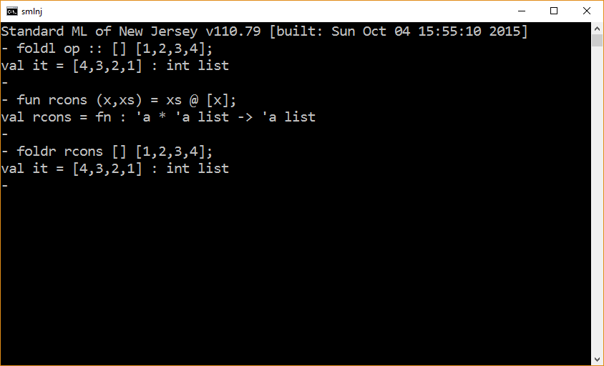

Slide 10
Crossproduct
fun cross x ys = map (fn y => (x,y)) ys;
fun crossProduct xs ys = map (fn x => cross x ys) xs;
crossProduct [1,2,3,4] [“a”,”b”,”c”];

Slide 11
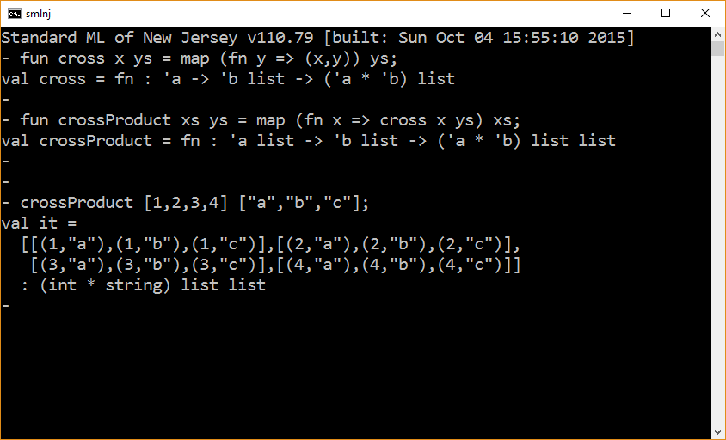

Slide 12
Optional Values
SOME or NONE

Slide 13
optional values
datatype int_option = SOME of int | NONE;
SOME 5;
NONE;
datatype 'a option = SOME of 'a | NONE;
SOME 5;
SOME true;
*the Option structure is part of the standard basis

Slide 14
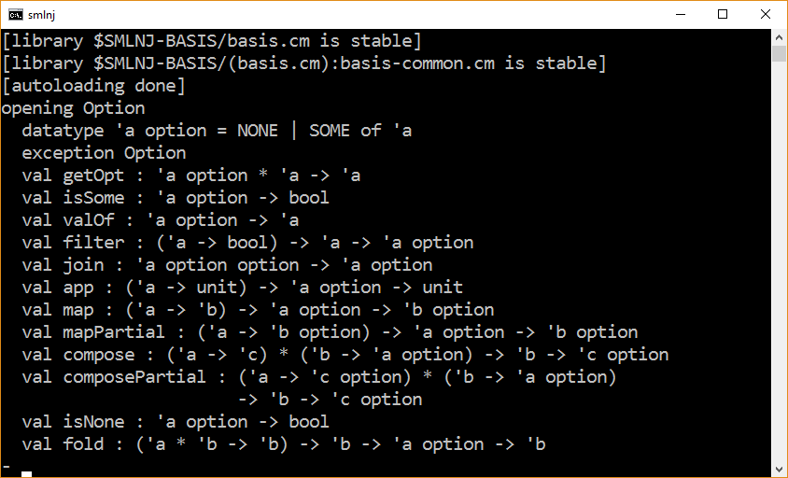

Slide 15
(* assumes at most one occurrence of loc1 in store *)
fun grab loc1 ((loc,dv),NONE ) = if loc1 = loc then SOME dv
else NONE
| grab _ (_ ,dvOpt) = dvOpt;
fun accessStore loc1 s = foldr (grab loc1) NONE s;
val s = [ (1,1), (2,4), (3,9) ];
accessStore 1 s;
accessStore 2 s;
accessStore 3 s;
accessStore 4 s;

Slide 16
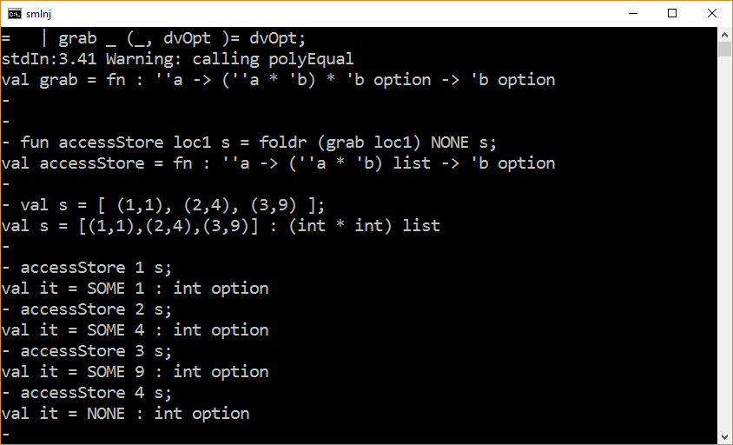

Slide 17
Final Example – Subtraction (?)
foldr op – 0 [1,2,3,4]; (* = ~2 *)
foldl op – 0 [1,2,3,4]; (* = 2 *)
1 – 2 – 3 – 4; (* = ~8 *)
(1−(2−(3−(4−0)))
(4−(3−(2−(1−0)))
Can you algebraically (i.e., symbolically) characterize what foldr is computing?

Slide 18
The end

